Slide 1





CONVOLUTIONAL
CODE
Kelompok 10

Slide 2




OUR TEAM
FAKHRI NUGRAHA PRATAMA (201344010)
MUHAMMAD YASA MAULANA (201344024)
RIZAL FADHILAH (201344030)

Slide 3


TABLE OF CONTENTS
DEFINITION
Pengertian Convolutional Code
01
HISTORY
Sejarah Convolutional Code
02
CONVOLUTIONAL CODE
Notasi, Polinomial, State table, State Diagram, Trellis Diagram,
03
EXAMPLE
Contoh Soal
04

Slide 4





01
DEFINITION
Pengertian

Slide 5





CONVOLUTIONAL
CODE
Salah satu jenis code yang bisa mendeteksi dan mengkoreksi error secara otomatis dan memiliki perbedaan mendasar dari blok kode. Dimana urutan blok informasi tidak di kelompok kelompokan dalam blok blok yang berbeda sebelum di kodekan.

Slide 6




02
HISTORY
Sejarah Singkat Convolutional Code

Slide 7




SEJARAH SINGKAT
PETER ELIAS
1955
Memperkenalkan Convolutional Coding sebagai
alternatif dari Blok Code atau Hamming Code.
ANDREW JAMES VITERBI
1967
Memperkenalkan Maksimum likelihood decoding untuk proses decoding convolutional Code.

Slide 8





03
CONVOLUTIONAL CODE
Notasi, Polinomial, State table, State Diagram, Trellis Diagram,

Slide 9
NOTASI
n = banyaknya bit
n output yang dihasilkan
dari encoder
Constraint Length adalah panjang data stream encoder (jumlah register yang digunakan)
L
k = banyaknya bit yang dimasukkan ke dalam shift register encoder
k
r = rate of efficiency r = k/n
r
* Penulisan variabel bisa jadi berbeda tiap referensi.

Slide 10
Diagram Blok
L = Constaint Length
Convolutional
Encoder
k-bit input
n-bit output
Rate = r = k/n

Slide 11
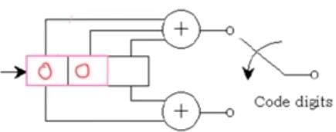
Rangkaian
Mod-2 adder
Switch
Output
Input
Shift Register
Mod-2 adder

Slide 12




METODE ENCODING
TABLE STATE
POLINOMIAL
STATE DIAGRAM
DIAGRAM TRELLIS
DIAGRAM TREE

Slide 13





04
EXAMPLE
Contoh Soal

Slide 14
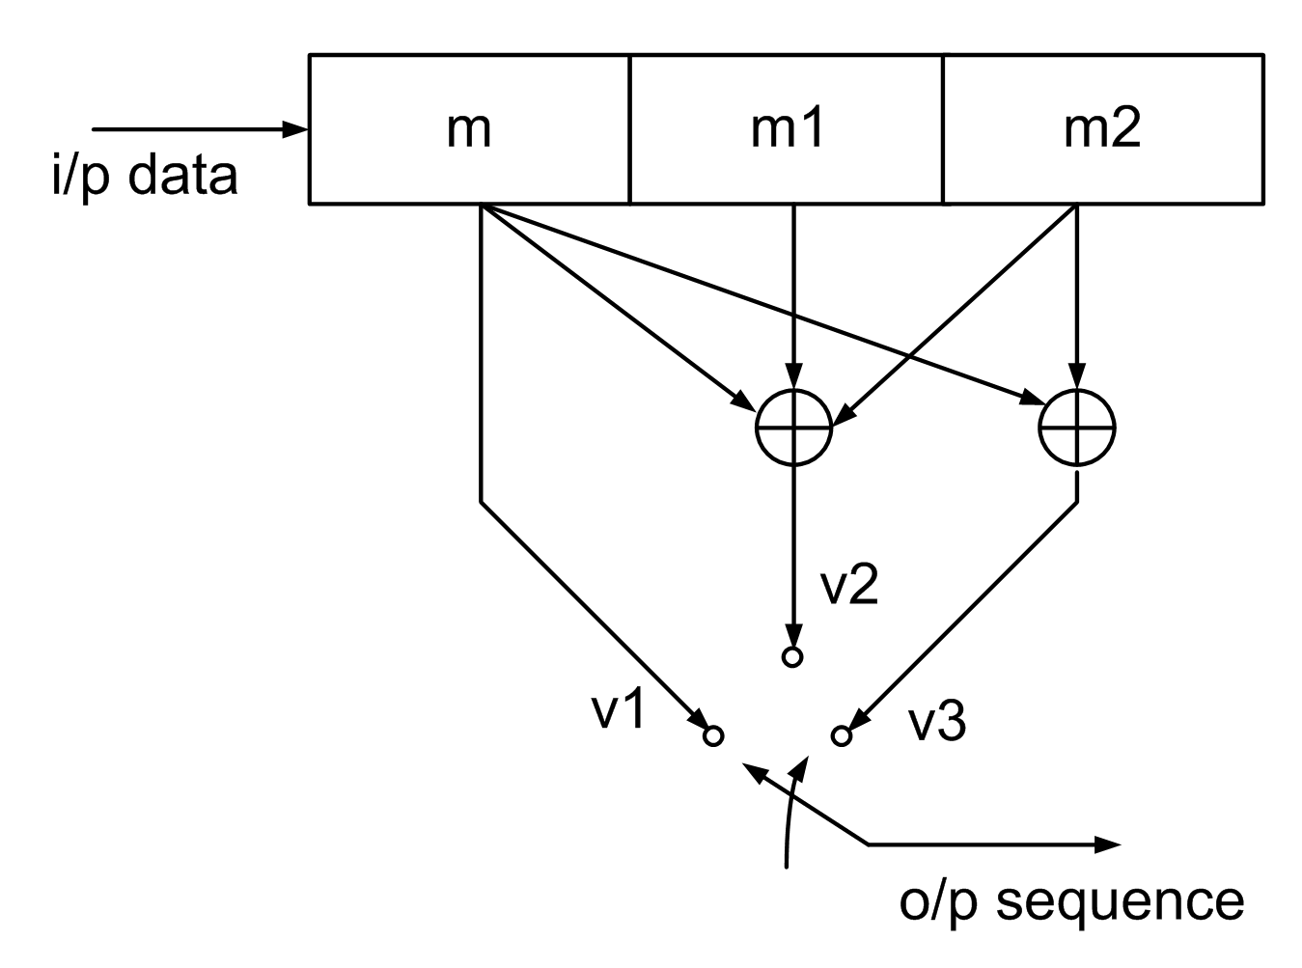
CONTOH SOAL
Diketahui data (D) = 1 0 0 1 1
Tentukan convolution code rate 1/3 dengan g1 (1,0,0) g2 (1,1,1) g3 (1,0,1)
1.
Analisa Rangkaian
Encoder (3,1,3) = encoder (n,k,L)
n = output = 3
k = input = 1
L = constraint length = 3
r = rate = k/n = 1/3
g1 = (1,0,0) = v1
g2 = (1,1,1) = v2
g3 = (1,0,1) = v3
Disini setiap input 1 bit akan menghasilkan output 3 bit.

Slide 15
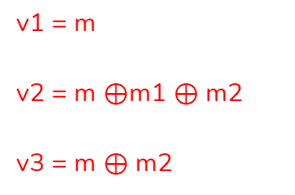
2.
Buat Tabel State
Msg | Current state |  | Output |  |  | Next state
msg | m1 | m2 | v1 | v2 | V3 | m m1
0 | 0 | 0 | - | - | - | 00
1 | 0 | 0 | 1 | 1 | 1 | 10
0 | 1 | 0 | 0 | 1 | 0 | 01
0 | 0 | 1 | 0 | 1 | 1 | 00
1 | 0 | 0 | 1 | 1 | 1 | 10
1 | 1 | 0 | 1 | 0 | 1 | 11
0 | 1 | 1 | 0 | 0 | 1 | 01
0 | 0 | 1 | 0 | 1 | 1 | 00
v1 = m
v2 = m $⊕$m1 $⊕$ m2
v3 = m $⊕$ m2
Hasil output = 111 010 011 111 101 001 011

Slide 16
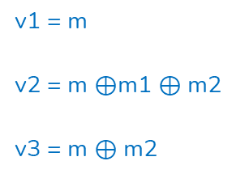
3.
Penyederhanaan dengan State Diagram
v1 = m
v2 = m $⊕$m1 $⊕$ m2
v3 = m $⊕$ m2
No | Current State |  | Input | Output |  |  | Next State | State
 | m1 m2 |  | Msg | v1 | v2 | v3 | msg m1
1 | a | 00 | 0 | 0 | 0 | 0 | 00 | a
 |  | 00 | 1 | 1 | 1 | 1 | 10 | c
2 | b | 01 | 0 | 0 | 1 | 1 | 00 | a
 |  | 01 | 1 | 1 | 0 | 0 | 10 | c
3 | c | 10 | 0 | 0 | 1 | 0 | 01 | b
 |  | 10 | 1 | 1 | 0 | 1 | 11 | d
4 | d | 11 | 0 | 0 | 0 | 1 | 01 | b
 |  | 11 | 1 | 1 | 1 | 0 | 11 | d
1 / 110
d
0 / 001
1 / 101
0 / 010
b
c
1 / 100
m1 | m2 | state
0 | 0 | a
0 | 1 | b
1 | 0 | c
1 | 1 | d
Data input : 1001100
0 / 011
1 / 111
Output: 111 010 011 111 101 001 011
a
Jika msg 0 :
Jika msg 1 :
0 / 000

Slide 17
4.
Penyederhanaan dengan Trellis diagram
No | Current State |  | Input | Output |  |  | Next State | State
 | m1 m2 |  | Msg | v1 | v2 | v3 | msg m1
1 | a | 00 | 0 | 0 | 0 | 0 | 00 | a
 |  | 00 | 1 | 1 | 1 | 1 | 10 | c
2 | b | 01 | 0 | 0 | 1 | 1 | 00 | a
 |  | 01 | 1 | 1 | 0 | 0 | 10 | c
3 | c | 10 | 0 | 0 | 1 | 0 | 01 | b
 |  | 10 | 1 | 1 | 0 | 1 | 11 | d
4 | d | 11 | 0 | 0 | 0 | 1 | 01 | b
 |  | 11 | 1 | 1 | 1 | 0 | 11 | d
000
000
000
000
a
a
a
a
a
111
111
111
011
111
011
b
b
b
b
b
100
100
010
010
c
c
c
c
010
c
Jika msg 0
101
101
101
Jika msg 1
001
001
d
d
d
d
d
110
110

Slide 18
000
000
000
000
000
000
000
a
a
a
a
a
a
a
a
111
111
111
011
111
011
111
011
111
011
111
011
b
b
b
b
b
b
b
b
100
100
100
100
100
010
010
010
c
010
c
010
010
c
c
c
c
c
c
101
101
101
101
101
101
001
001
001
001
001
001
d
d
d
d
d
d
d
d
110
110
110
110
110
Jika msg 0
Data input : 1001100
Jika msg 1
Output: 111 010 011 111 101 001 011

Slide 19
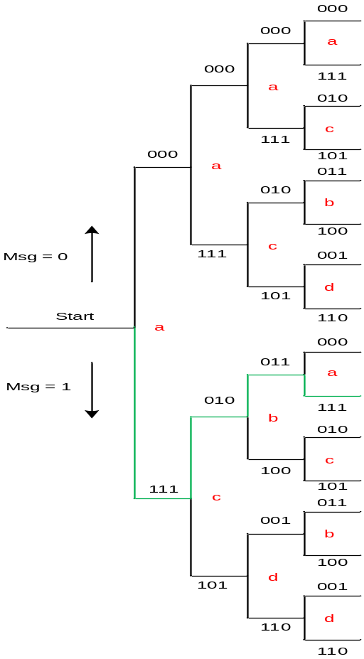
5.
Penyederhanaan dengan Tree diagram
No | Current State |  | Input | Output |  |  | Next State | State
 | m1 m2 |  | Msg | v1 | v2 | v3 | msg m1
1 | a | 00 | 0 | 0 | 0 | 0 | 00 | a
 |  | 00 | 1 | 1 | 1 | 1 | 10 | c
2 | b | 01 | 0 | 0 | 1 | 1 | 00 | a
 |  | 01 | 1 | 1 | 0 | 0 | 10 | c
3 | c | 10 | 0 | 0 | 1 | 0 | 01 | b
 |  | 10 | 1 | 1 | 0 | 1 | 11 | d
4 | d | 11 | 0 | 0 | 0 | 1 | 01 | b
 |  | 11 | 1 | 1 | 1 | 0 | 11 | d
Data input : 1001100
Output: 111 010 011 111 101 001 011

Slide 20


CONTOH SOAL POLINOMIAL
Diketahui data (D) = 1 0 0 1 1
g(1) = {1 0 0}
g(2) = {1 1 1 }
g(3) = {1 0 1}
2.
Kalikan data (d) dengan g(2)
1
1 0 0 1 1
1 1 1
Kalikan data (d) dengan g(1)
x
3
1 0 0 1 1
1 0 0
1 0 0 1 1
Kalikan data (d) dengan g(3)
x
1 0 0 1 1
1 0 0 1 1
0 0 0 0 0
$$⊕$$
1 0 0 1 1
1 0 1
0 0 0 0 0
1 1 1 1 0 0 1
x
1 0 0 1 1
$$⊕$$
1 0 0 1 1
C(2) = 1 1 1 1 0 0 1
1 0 0 1 1 0 0
0 0 0 0 0
$$⊕$$
C(1) = 1 0 0 1 1 0 0
1 0 0 1 1
1 0 1 1 1 1 1
C(3) = 1 0 1 1 1 1 1

Slide 21
4.
Pasangkan C(1), C(2) dan C(3)
C(1) = 1 0 0 1 1 0 0
C(2) = 1 1 1 1 0 0 1
C(3) = 1 0 1 1 1 1 1
Convolution code output
= 111 010 011 111 101 001 011

Slide 22
CONTOH SOAL
Diketahui data (D) = 1 0 0 1 1
Tentukan convolution code jika menggunakan rangkaian encoder (2,1,3)
Encoder (2,1,3) = encoder (n,k,L)
k = input = 1 n = output = 2
L = constraint length = 3
1
Analisa Rangkaian
output 1
input
r = rate = k/n = 1/2
artinya 1 bit input, encoder menyiapkan 2 bit output. Encoder memproses 1 bit at a time
output 2
Constraint length

Slide 23
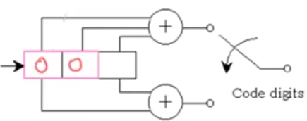
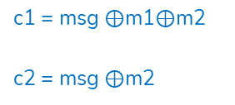
2.
Buat Tabel State
c1 = msg $⊕$m1$⊕$m2
c2 = msg $⊕$m2
msg
m1
m2
C1
1.
0
0
0
Tabel XOR
Input |  | Output
A | B
0 | 0 | 0
0 | 1 | 1
1 | 0 | 1
1 | 1 | 0
1 1 0 0 1
msg | Current state |  | Output
msg | m1 | m2 | c1 | c2
0 | 0 | 0 | - | -
1 | 0 | 0 | 1 | 1
0 | 1 | 0 | 1 | 0
0 | 0 | 1 | 1 | 1
1 | 0 | 0 | 1 | 1
1 | 1 | 0 | 0 | 1
0 | 1 | 1 | 0 | 1
0 | 0 | 1 | 1 | 1
C2
2.
1
1 1 0 0
1
0
0
1
1
3.
0
1 1 0
1
0
0
Keterangan:
msg = message / register
m1 dan m2 = current state /register
c1 dan c2 = output
Hasil output = 11 10 11 11 01 01 11

Slide 24
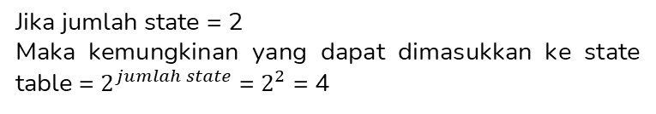
3.
Mengkodekan
Jika jumlah state = 2
Maka kemungkinan yang dapat dimasukkan ke state table = $2^{jumlah state}$= $2^{2}$ = 4
Kemungkinan bit pada state table yaitu:
m1 | m2 | state
0 | 0 | a
1 | 0 | b
0 | 1 | c
1 | 1 | d
msg
m1
m2
m1 dan m2 merupakan state yang digunakan pada encoder .
Maka jumlah state = 2

Slide 25
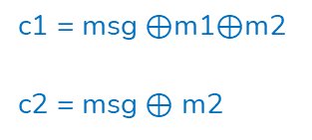
4.
Penyederhanaan dengan State Diagram
c1 = msg $⊕$m1$⊕$m2
c2 = msg $⊕$ m2
No | Current State |  | Input | Output |  | Next State | State
 | m1 m2 |  | msg | c1 | c2 | msg m1
1 | a | 00 | 0 | 0 | 0 | 00 | a
 |  | 00 | 1 | 1 | 1 | 10 | c
2 | b | 01 | 0 | 1 | 1 | 00 | a
 |  | 01 | 1 | 0 | 0 | 10 | c
3 | c | 10 | 0 | 1 | 0 | 01 | b
 |  | 10 | 1 | 0 | 1 | 11 | d
4 | d | 11 | 0 | 0 | 1 | 01 | b
 |  | 11 | 1 | 1 | 0 | 11 | d
1 / 10
d
1 / 01
0 / 10
0 / 01
b
c
1 / 00
m1 | m2 | state
0 | 0 | a
1 | 0 | b
0 | 1 | c
1 | 1 | d
Data input : 1001100
0 / 11
1 / 11
Output: 11 10 11 11 01 01 11
a
Jika msg 0 :
Jika msg 1 :
0 / 00

Slide 26
5.
Penyederhanaan dengan Trellis diagram
No | Current State |  | Input | Output |  | Next State | State
 | m1 m2 |  | msg | c1 | c2 | msg m1
1 | a | 00 | 0 | 0 | 0 | 00 | a
 |  | 00 | 1 | 1 | 1 | 10 | c
2 | b | 01 | 0 | 1 | 1 | 00 | a
 |  | 01 | 1 | 0 | 0 | 10 | c
3 | c | 10 | 0 | 1 | 0 | 01 | b
 |  | 10 | 1 | 0 | 1 | 11 | d
4 | d | 11 | 0 | 0 | 1 | 01 | b
 |  | 11 | 1 | 1 | 0 | 11 | d
00
00
00
00
a
a
a
a
a
11
11
11
11
11
11
b
b
b
b
b
00
00
10
10
Jika msg 0
c
c
c
c
10
c
01
01
Jika msg 1
01
01
01
d
d
d
d
d
01
01

Slide 27
00
00
00
00
00
00
00
a
a
a
a
a
a
a
a
11
11
11
11
11
11
11
11
11
11
11
11
b
b
b
b
b
b
b
b
00
00
00
00
00
10
10
10
10
10
10
c
c
c
c
c
c
c
c
01
01
01
01
01
01
01
01
01
01
01
d
d
d
d
d
d
d
d
01
01
01
01
01
Jika msg 0
Data input : 1001100
Jika msg 1
Output: 11 10 11 11 01 01 11

Slide 28
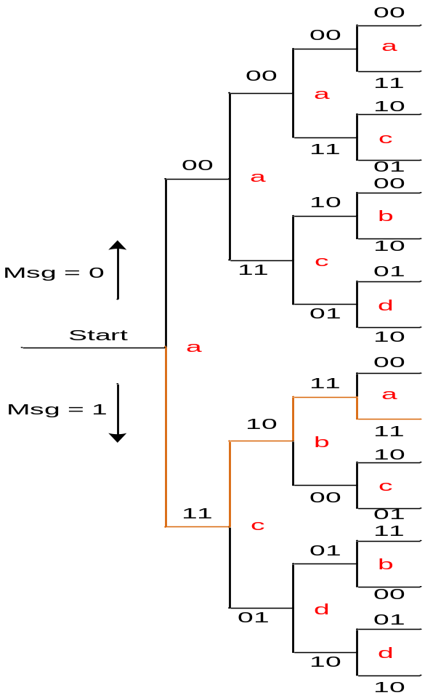
6.
Penyederhanaan dengan Tree diagram
No | Current State |  | Input | Output |  | Next State | State
 | m1 m2 |  | msg | c1 | c2 | msg m1
1 | a | 00 | 0 | 0 | 0 | 00 | a
 |  | 00 | 1 | 1 | 1 | 10 | c
2 | b | 01 | 0 | 1 | 1 | 00 | a
 |  | 01 | 1 | 0 | 0 | 10 | c
3 | c | 10 | 0 | 1 | 0 | 01 | b
 |  | 10 | 1 | 0 | 1 | 11 | d
4 | d | 11 | 0 | 0 | 1 | 01 | b
 |  | 11 | 1 | 1 | 0 | 11 | d
Data input : 1001100
Output: 11 10 11 11 01 01 11

Slide 29





“SELESAI SUDAH PRESENTASI KITA HARI INI, SEPERTI KAMU
DAN DIA YANG SELESAI
TANPA PERNAH DIMULAI ”
—SOMEONE FAMOUS

Slide 30





TERIMA
KASIH

